Slide 1
MULTI-LEVEL PIE CHART

Slide 2
CONTENTS
PIE Chart
Multi-Level Pie Chart
Tools Used
Tree Vs MLPC
Advantages
Disadvantages
References

Slide 3
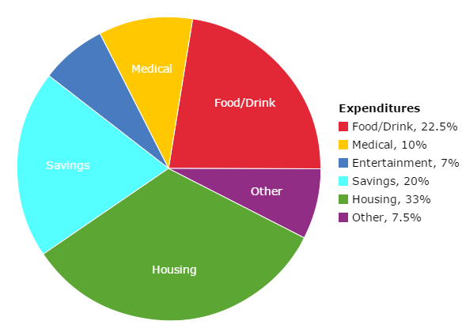
PIE CHART
Pie charts helps us to show the proportions and percentages between categories.
Each arc represents a proportion of each category.
Total sum of data should be 100%.

Slide 4
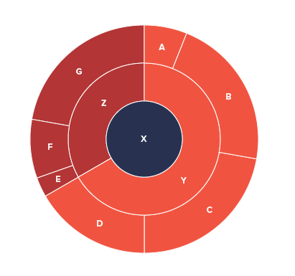
Multi-level pie chart
Consolidated Pie Structure.
Set of Concentric Rings.
Represents Hierarchical Data.
Allow us to show Symmetrical and Asymmetrical Tree structure.
Divides the Visual segments.
Visual Path tracing from any child to parent.
Equal Distribution – Symmetric.
Unequal Distribution – Asymmetric.

Slide 5
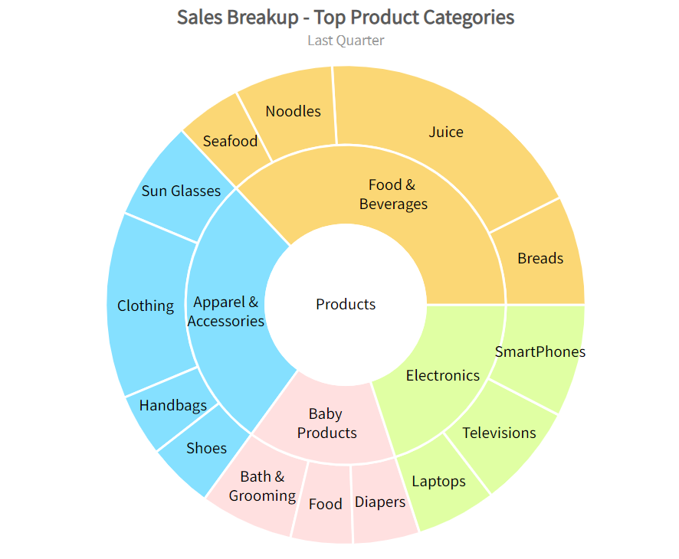
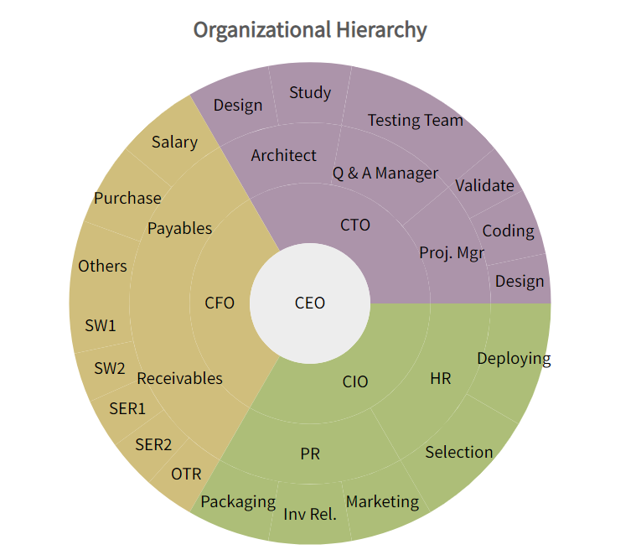
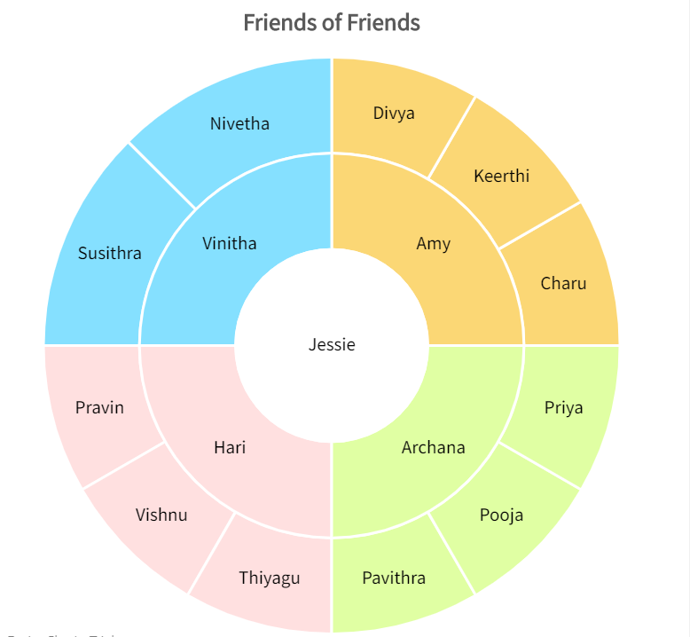
Types of data used
Organization Structure
Interlinked Tree Data
Sales Breakup

Slide 6
TOOLS USED
R
Python
Microsoft Excel
D3.js

Slide 7
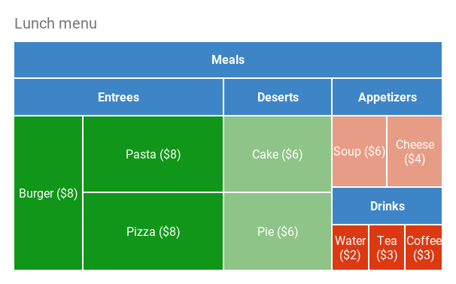
TREE VS Multi-level pie chart

Slide 8
ADVantages
Effective and Interactive communication tool.
Can see a data comparison and distribution at a glance.
Helps us to make an immediate analysis.

Slide 9
disadvantages
Less Effective when large number levels is used.
Unhelpful when observing trends over time.

Slide 10
REFERENCES
https://www.fusioncharts.com/resources/chart-primers/multi-level-pie-chart
https://www.fusioncharts.com/dev/chart-guide/standard-charts/multi-level-pie-chart

Slide 11
THANK YOU

